Slide 1
Choosing a franchise

Slide 2

Industry – food industry
Advantages:
Brand
Clients
Location
Staff
Disadvantages:
Location
Equipment
Staff

Slide 3
Franchise offers

Slide 4

BOBO Bar Bubble Tea
Number of franchisees
7 in Ukraine
Year of start of franchising program
2012
Fees and costs
Cost – 150k – 330k ₴
Fee 5% after 7th month
Requirements
-
Conditions
No, because they have different types of bars
Payback and profitability
6 – 12 month

Slide 5

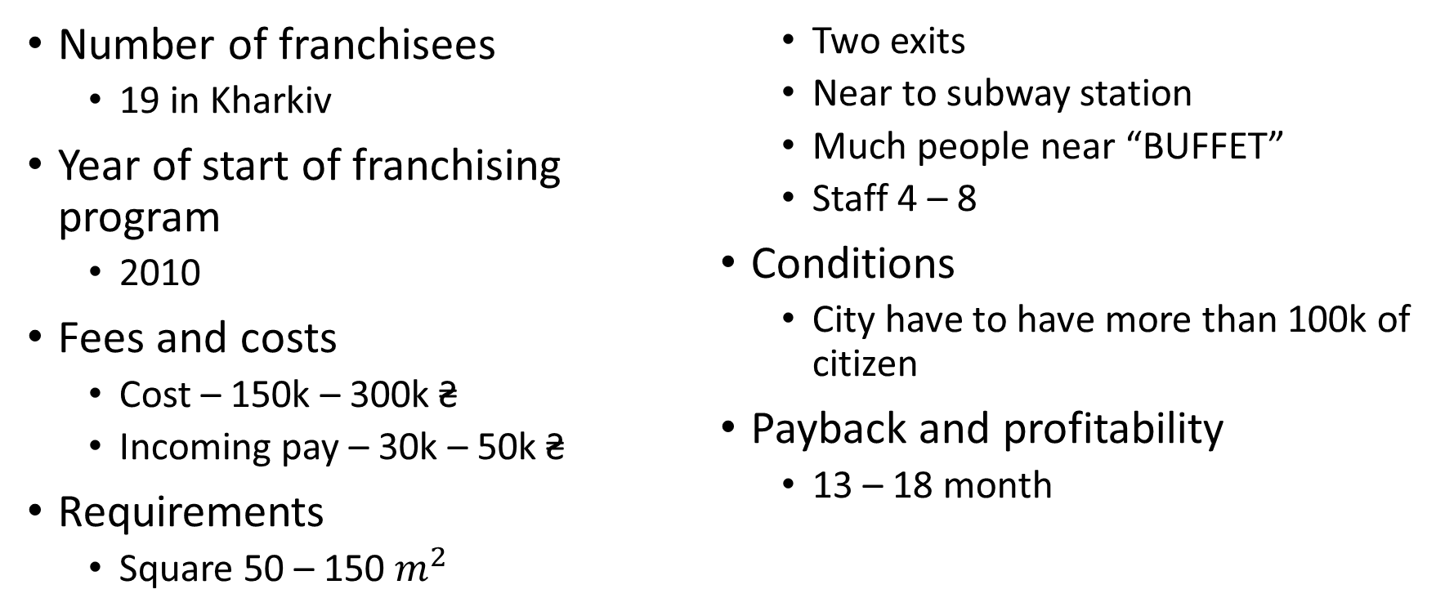
BURGERS BUFFET
Number of franchisees
19 in Kharkiv
Year of start of franchising program
2010
Fees and costs
Cost – 150k – 300k ₴
Incoming pay – 30k – 50k ₴
Requirements
Square 50 – 150 $m^{2}$
Two exits
Near to subway station
Much people near “BUFFET”
Staff 4 – 8
Conditions
City have to have more than 100k of citizen
Payback and profitability
13 – 18 month

Slide 6

KFC
Number of franchisees
27 760 in the world
51 in Ukraine
Year of start of franchising program
1952
Fees and costs
Cost – 700k $
Incoming pay – 47k $
Royalty 6%
Requirements
Not found
Conditions
Experience in finance
Experience of management
Experience of marketing
Trust
Payback and profitability
36 month

Slide 7
The most appropriate offer

Slide 8

BOBO Bar Bubble Tea
Advantages:
The cheapest franchise
Has less requirements
The fastest payback
Less fee
Delicious

